Slide 1
ATM PROJECT
PRESENTATION BY :-
SHAKTI PRASAD MOHANTY – XI-A
SOHAM MAITY – XI-A

Slide 2
About the project…..
This project shows as to how an ATM(Automated Teller Machine) works in real life.
This project is made fully through Python programming language.
It holds numerous activities like withdrawing money, depositing money, checking your available balance, creating a new account and some other features that a real life ATM does.

Slide 3
ATM Simulator project is written in Python. The project file contains a python script (FINAL_atmprojectcode.py). This is a simple console based system which is very easy to use. Talking about the system, it contains various options which include Create Account, Depositing amount, Withdrawing money, PIN change and View balance. Here, at first the user has to enter an username, PIN and based on these; system will provide an fully personal & unique ID. Then system will proceed toward the next procedure i.e asking PIN number & ID. When a user passes all these sign-in procedures, he/she can use all those features. It is too easy to use, he/she can check their respective account statements.
While depositing or withdrawing amount, he/she just has to enter the amount then the system calculates the total remaining balance of the respective account and displays to the user. And the user can view all these transactions from the account statement. In this ATM Simulator, the user can also change the PIN number. For this, the user has to enter the New pin code and then confirm it in order to change the pin code. This simple console based ATM simulator provides the simple account balance management of a respective account. It contains all the essential features. There is no database connection or neither any external text or other files used in this mini project to save user’s data. Everything is set inside the source code whether its pin code or the amount.

Slide 4
Working and outputs

Slide 5
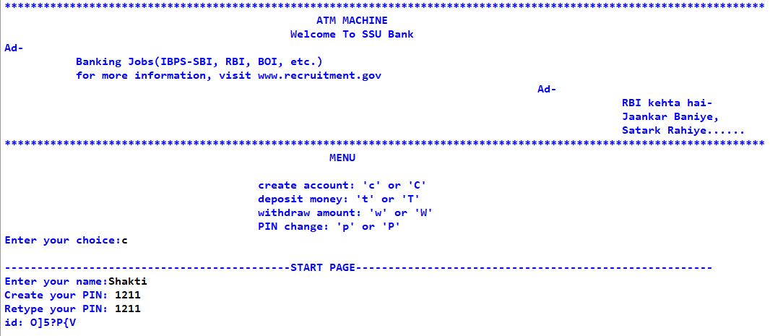
START PAGE

Slide 6
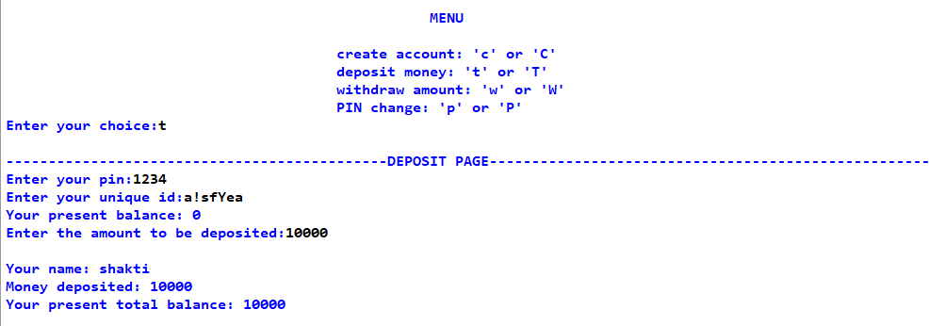
Deposit Page

Slide 7
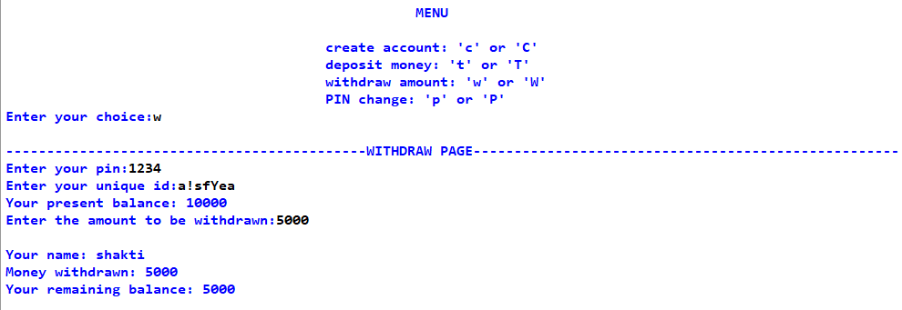
Withdraw Page

Slide 8
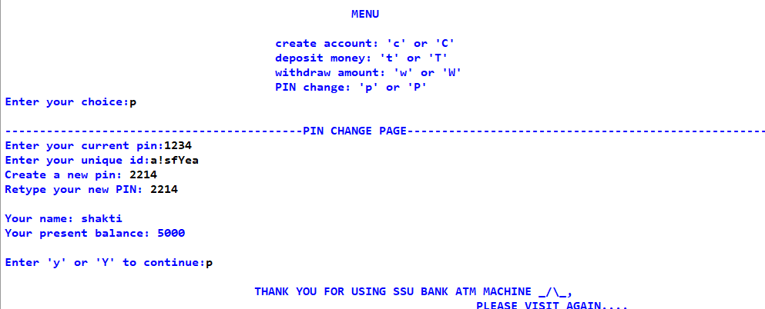
Pin change page

Slide 9
DATA FLOW DIAGRAM

Slide 10
Level 0
Open window
Create account.
If account already exists, the login with username and pin.
This is where you login with your pin.

Slide 11
LEVEL 1
ATM
System
Deposit Money
Withdraw Money
Change Your Pin
Check Balance
Main working DFD of the whole ATM system.

Slide 12
SCOPE OF THE PROJECT
This project can be used to simulate the basic working of a real life ATM.
It contains main features namely Deposit Money, Withdraw Money, Check Your Balance, which can be accessed by logging in with your pin.

Slide 13
UTILITY OF THE PROJECT
It can be used as a base for creating a real-life ATM software.
This project can be used for gaining the knowledge of using an ATM, rather than using the real one and damaging your account propaganda.
A ATM Software In Python is a simple console based ATM simulator provides the simple account balance management of a respective account. It contains all the essential features. There is no database connection or neither any external text or other files used in this mini project to save user's data.

Slide 14
THANK YOU!!!

